Slide 1

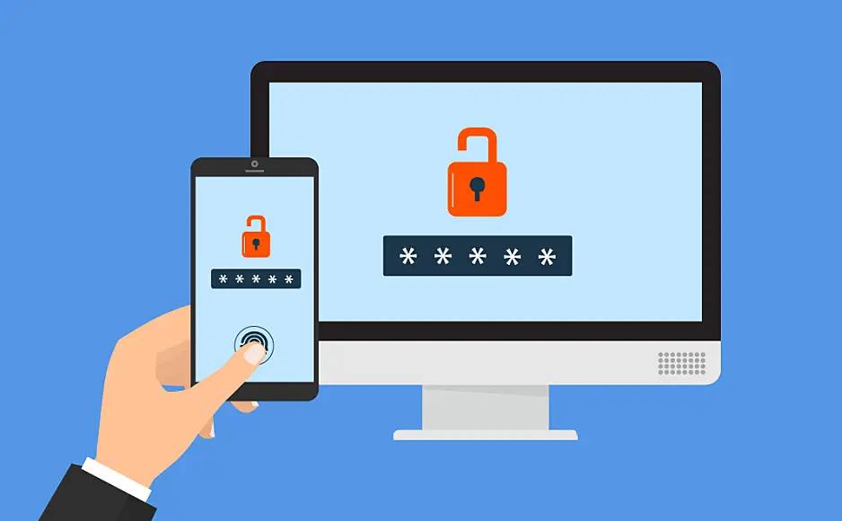
MDM App Authentication
Can Mobile Device Management authenticate apps?
By, Anthony Zatika
Notes:
Hello, welcome to my presentation where I will be showcasing MDM app authentication for all mobile devices.

Slide 2
Agenda
App Security/Authentication
IOS MDM App Authentication
Android MDM App Authentication
Other Device MDM Authentication
Questions/Concerns
Next Weeks Ideas
Notes:
For the agenda today, I will start off by explaining App Security and the need for authentication. I will then explain how IOS tackles MDM app authentication. Followed by how Android tackles MDM app authentication. I will also expand into other device MDM authentication, and I will finish up with my questions/concerns. At the end of my presentation, I will give my next weeks ideas.

Slide 3
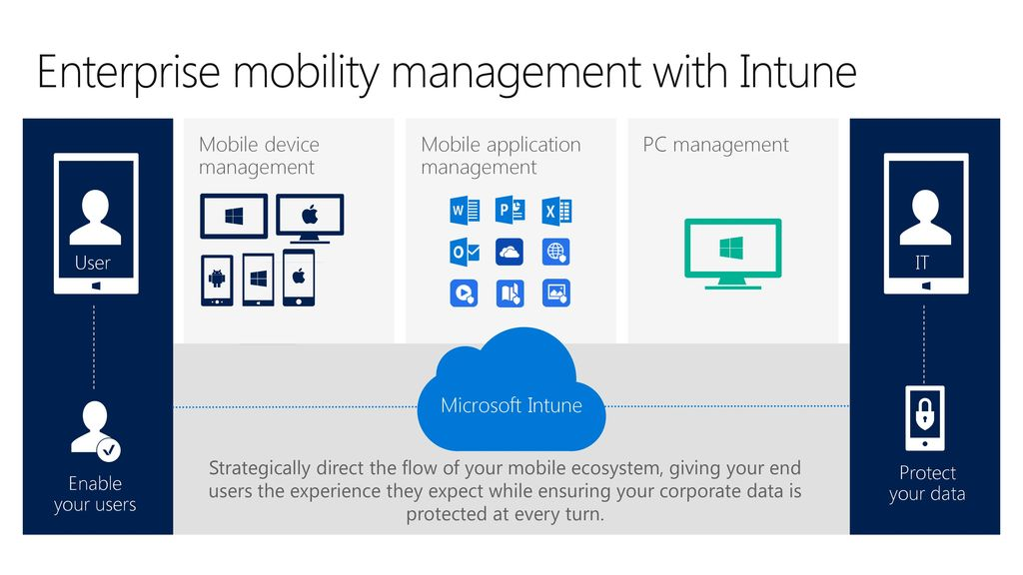
App Security/Authentication
iPhone Apps
Android Apps
Same Security
Security Liability
Notes:
I want to start off and explain why app security and authentication is so paramount in the first place. According to researchers studying the Checkra1n jailbreak, which is responsible for cracking open the software of any iPhone model ranging from the iPhone 4s to the iPhone X, “’I discovered that it is true what I had heard -- that iOS apps are just as bad as Android apps,’ Bowne said, even though ‘the [iOS] operating system is a little more secure, and the coding language is harder to reverse engineer.’” (Wagenseil, 2020). Surprisingly, iOS is just as vulnerable to attacks from apps than Android. As Bowne put it, “’It's painfully obvious… that the standards of most app developers are extremely low, and that the management [of the companies that use the apps] does not review the security of apps they purchase from third-party developers, not even for the simplest flaws’” (Wagenseil, 2020). This is precisely the reason why App Security/Authentication is so badly needed for mobile devices. Having employees run exploitable apps in a BYOD network is a severe security liability.

Slide 4
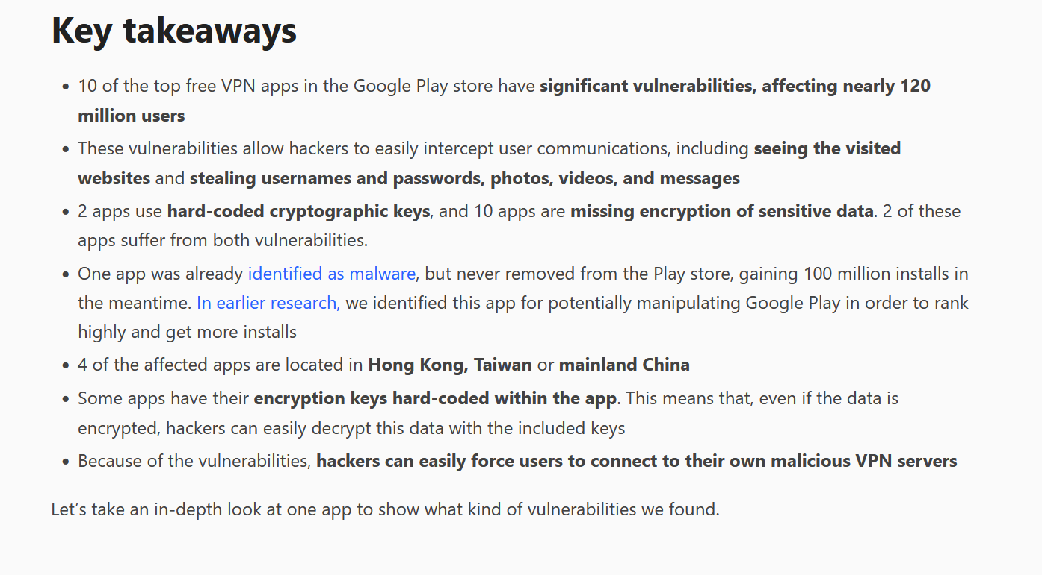
Examples
SuperVPN
MITM Attacks
Notes:
There are innumerable articles written about iOS and Android’s vulnerable apps leaking information to threat nation states. For example, an app called SuperVPN which has been removed from the Google Play store had grave security holes. SuperVPN, “[has exposed] more than 105 million people [that] could right now be having their credit card details stolen, their private photos and videos leaked or sold online, every single minute of their private conversations recorded and sent to a server in a secret location. They could be browsing a fake, malicious website set up by the hacker and aided by these dangerous VPN apps” (Youngren, 2021). SuperVPN was vulnerable to MITM attacks meaning that the VPN either was not encrypting the traffic at all or had used a terrible encryption schema. As seen in the picture, there was already one app that was identified as legitimate malware gaining 100 million installs. You can also see that 10 of the top free VPN apps on the Google Play store have severe issues that affect 120 million users.

Slide 5

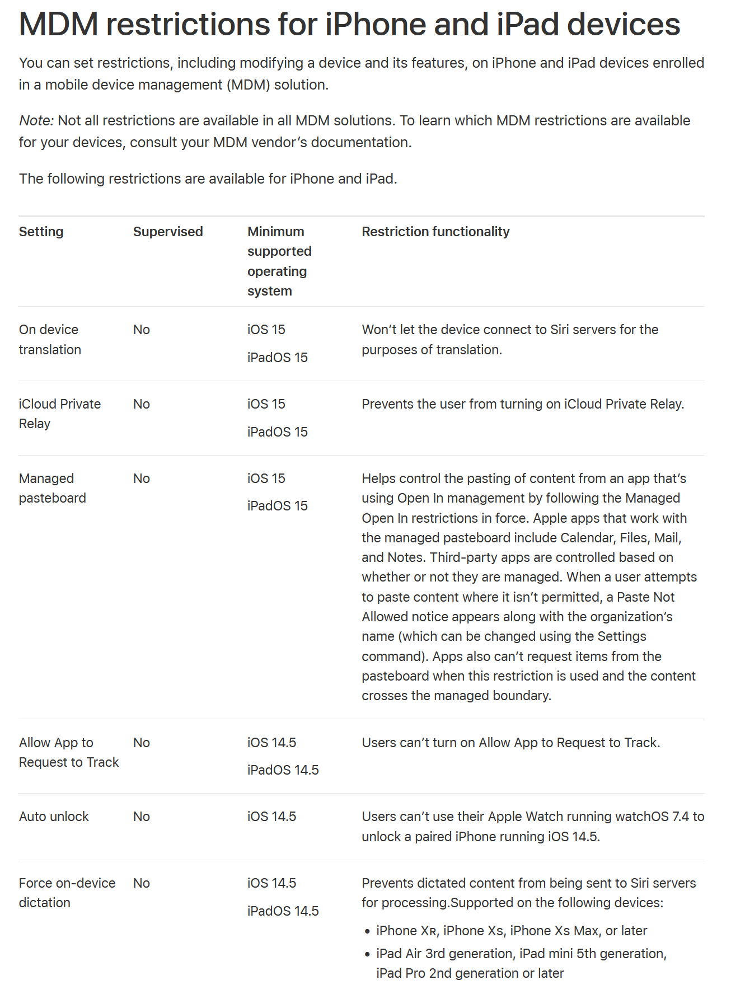
IOS App Authentication
On Device Translation
iCloud Private Relay
Allow App to Request to Track
Auto Unlock
Custom App Configuration
App Tunnel using Per App VPN
Device Passcode and Touch ID
Managed Open In for Files
Prevent App Backup
Disable Screen Capture
Enforce App Encryption
Remotely Wipe App and Data
Disable Copy Paste
Notes:
In this next slide, you can see that Apple kindly provides a list of all restrictions that MDM solutions can employ. Most notably, MDM solutions such as IBM and Microsoft can create an app blacklist where unauthorized apps can not be run. This is to ensure that if there is a known malicious app on the Google Play store, gullible employees are unable to install or run the app. Other than that, MDM solutions can turn off on device translation, auto unlock, copy paste, custom app configurations, disable screen capture, enforce app encryption, and even remotely wipe apps and data. This, of course, is not an exhaustive list, but this ensures that if a malicious app manages to get through the Google Play or App Store, there are limited attack vectors in which the app can attack. You can be assured that with any notable MDM solution, your mobile devices will be kept secure.

Slide 6
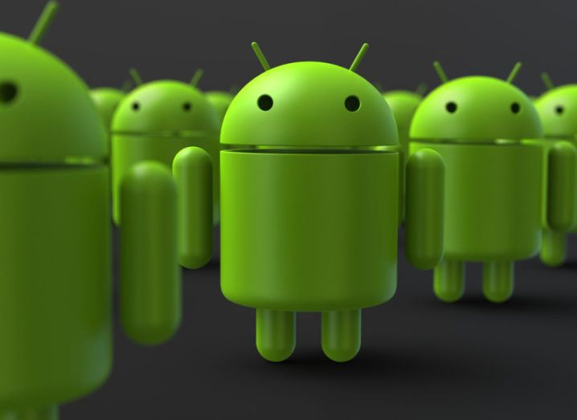
Android App Authentication
Data at Rest Security
Remote App and Data Wipe
Secure Tunneling
Preventing Data Leaks
App Passcodes
Notes:
Android mobile devices share some of the same MDM restrictions as iOS mobile devices. Since Android and iOS have virtually the same functionality, they will have the same protections. The only difference between iOS and Android is that MDM solutions focus a bit more on data and reset security. This is because Android mobile devices have the capability of apps running root privileges. Of course, this means that Androids have more exploits when referencing rooting. The only way iOS would be vulnerable to rooting in other words rootkitting is if the mobile device was jailbroken. Other than that, MDM solutions can secure both Android and iOS devices extremely well. Most notably, MDM solutions can prevent Android users from turning off App Passcodes, prevent data leaks, create secure VPN tunnels, remote control mobile devices, wipe data, and even prevent users from resetting core security features.

Slide 7

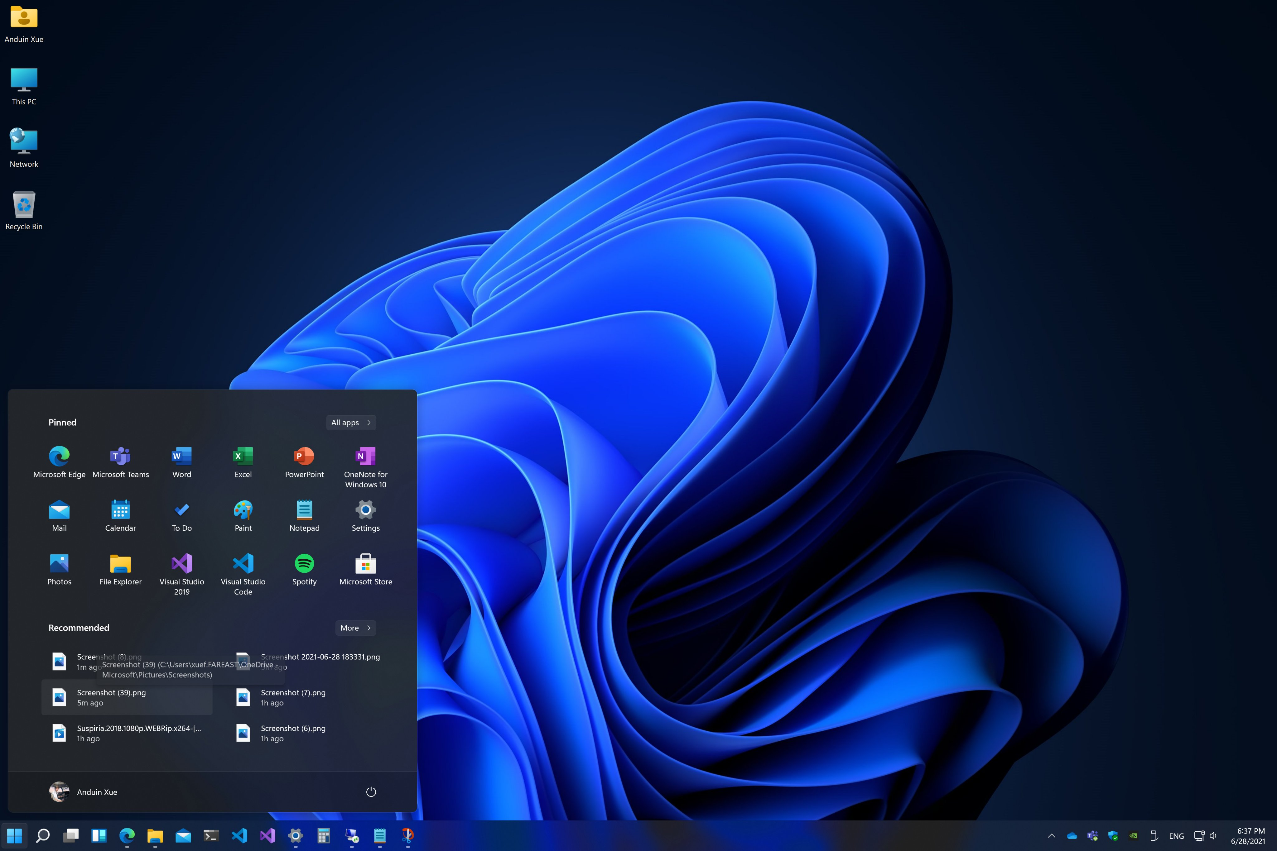
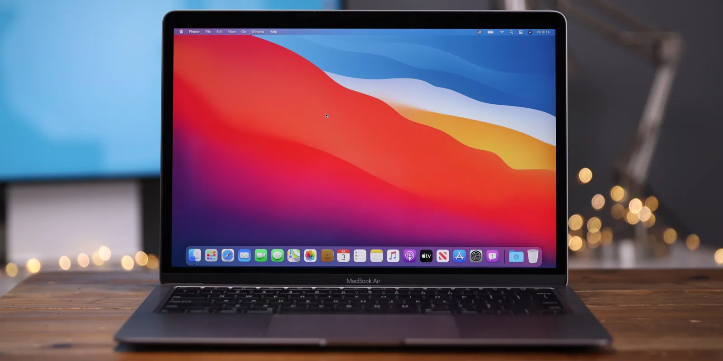
Other Mobile Devices
Windows
MacOS
Linux - (Ubuntu, Debian)
Notes:
Now, as you can tell iOS and Android devices are protected through MDM solutions. However, are other operating systems that can be run on Laptops or Desktops protected? The answer is yes, in this slide, you can see that other mobile devices such as Windows, MacOS, and even different flavors of Linux are protected by MDM solutions. In fact, according to IBM and Microsoft, their MDM solutions can be installed on just about any operating system that is well known. All devices are not impervious to attacks/human curiosity; therefore, MDM solutions can block apps, auto encrypt VPN tunnels and stop CUI from being sent to outside organizations on all different devices. No matter what the use case, IBM or Microsoft’s MDM solutions are there to secure companies managing a BYOD network.

Slide 8
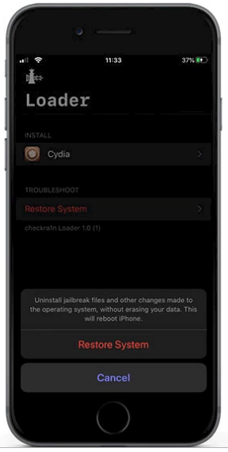
Questions/Concerns
MDM on Jailbroken Phone
Pain to sell your phone
Notes:
Unfortunately, I have some questions and concerns. First off, as explained in slide three, researchers were studying the Checkra1n jailbreak to take a look at app secure for the iPhones. However, any normal user can install Checkra1n and inevitably disable any MDM that are on enrolled devices. The worst part is that companies may not even know because in a BYOD networks there are hundreds/thousands of devices in a MDM portal. No one will know that one phone is disabled. Although apple is the safest, jailbreaking your iPhone makes it just as vulnerable or even more vulnerable than Android. Apple was not made to be able to have root access. On the other hand, it must be a pain to be able to sell your iPhone. An employee would have to explain to the company that they want to upgrade their phone or switch phones and have them disable the MDM.

Slide 9
Next Week
Privacy Implications
Hackers Can Steal MDM’s Gathered Data
Safety of MDM solutions
Notes:
This concludes my presentation, next week I would like to focus on the privacy implications of MDM solutions on employees. More specifically, does MDM’s data gathering put employees at more risk than normal? Also, what is the real safety of MDM solutions?

Slide 10
References
Adorno, J., Lovejoy, B., Espósito, F., Potuck, M., Chambers, B., McDaniel, A., & Post, S. (n.d.). 9to5Mac. Retrieved June 27, 2022, from https://9to5mac.com/
BEI Facebook anmelden. Facebook. (n.d.). Retrieved June 27, 2022, from https://de-de.facebook.com/myreadables/posts/httpsi1wpcommyreadablescomwp-contentuploads201902rm_ah2png/643345819419345/
Business benefits of Mobile Device Management (MDM). Techfunnel. (2020, March 3). Retrieved June 27, 2022, from https://www.techfunnel.com/information-technology/benefits-mobile-device-management/
Dansimp. (n.d.). MDM enrollment of Windows 10-based devices - windows client management. Windows Client Management | Microsoft Docs. Retrieved June 27, 2022, from https://docs.microsoft.com/en-us/windows/client-management/mdm/mdm-enrollment-of-windows-devices
IOS jailbreak online. iOS - Jailbreak Online. (2022, June 22). Retrieved June 27, 2022, from https://zeejb.com/
MDM restrictions for iPhone and iPad devices. Apple Support. (n.d.). Retrieved June 27, 2022, from https://support.apple.com/guide/deployment/restrictions-for-iphone-and-ipad-dep0f7dd3d8/web
Pulsedive. (n.d.). Threat intelligence. Pulsedive. Retrieved June 27, 2022, from https://pulsedive.com/ioc/cdn.mos.cms.futurecdn.net
Restrictions. (n.d.). Retrieved June 27, 2022, from https://www.ibm.com/docs/en/maas360?topic=cpsad-restrictions
Software, iA. (n.d.). IActivate.host Mdm Bypass. Download.com. Retrieved June 27, 2022, from https://download.cnet.com/iActivate-host-MDM-Bypass/3000-18553_4-78237396.html
Technology, science and start-up news. Silicon Republic. (2022, June 27). Retrieved June 27, 2022, from https://www.siliconrepublic.com/
Wagenseil, P. (2020, August 11). IPhone apps just as unsafe as Android apps, says security researcher. Tom's Guide. Retrieved June 27, 2022, from https://www.tomsguide.com/news/bad-ios-android-apps-bowne-dc28

